Slide 1


Collaborating for health equity: what comes first?
May, 2015
Dr. Patricia O’Campo
Amy Katz
Centre for Research on Inner City Health
St. Michael’s Hospital

Slide 2
Disclosure of commercial support
CFPC Conflict of Interest
Presenter Disclosure
Presenter: Amy Katz and Judith Otto
Relationships with commercial interests:
  Grants/Research Support: None
  Speakers Bureau/Honoraria: None
  Consulting Fees: None
  Other: None

Slide 3
We were asked by the World Health Organization to answer this question: What is the best way to bring different stakeholders together to collaborate for health equity in urban settings?
Notes:
- We were asked by the WHO to answer this question for a 2014 conference of major world cities in Hyderbad, India.
- We’re now working on it for publication, so this is emerging research, and we’d like to hear at the end of the presentation what would be useful to you.

Slide 4
Getting started
How we approached the question
had a lot to do with our work and experiences.
Notes:
Presenters explaining where they’re coming from with this
Amy:
Working in social services, seeing engagement processes that didn’t always lead somewhere concrete, and that at times hurt and disappointed people who had put some faith in it.
Questions around the best way to engage (or not to engage) civic and radical energy of community members, frontline workers.
Words that sounded good on the surface – like collaboration – sometimes turned out not to be so friendly.
Positioning myself, and thinking about positioning myself, how invested I am in actually am in making change, will I water down certain discussions out of self-interest, when is it most constructive for me to stay out of it, etc. The same questions we have to ask about our institutions…
So, wanted to work in research for awhile, to take some distance, and to be able to explore some of these processes, how they’re playing out in other jurisdictions, what they mean on a big picture level, etc.
Dr. O’Campo
- Not able to make it as she’s teaching in the US right now, but she is a scientist, trained as an epidemiologist, so she is looking at evidence, looking for patterns, and the mechanisms behind what is happening. And very invested in making change.

Slide 5
We had to spend some time unpacking the question and defining our terms.
We’re saying equity and collaboration all the time, but we rarely make precise what we mean.
Notes:
Very important to define terms – phrases like ‘health equity’ get used a lot, but what do we really mean when we say them? For the purposes of our research, we defined this as access to the social determinants of health for everyone, in the way that works for them/us (i.e. the ways that individuals and communities define both health and its determinants).
- Even more important was how to define collaboration. In the question – we assumed the convener to be the city government, or a large organization. If this is the case, what does ‘collaboration’ mean when the terms of the collaboration are being set by a specific party? And, if they aren’t, which aspects of the process are mutable, and which aren’t? We decided to define collaboration as an equitable decision making process some or all aspects of which would be binding, and which had purvey over meaningful decisions/resources.
We also had to define what we meant by ‘stakeholders’ – particularly from the perspective of grassroots voices. Sometimes civil society is used as a blanket term, but what does this mean? There’s a good discussion about from Richard Pithouse, a South African academic, and Marcelo Lopes de Souza, an academic in Brazil. Non-governmental groups aren’t always grassroots, and grassroots groups/movements are not always progressive. So we were really thinking about how organizations can collaborate with grassroots, PROGRESSIVE, movements. And I think it’s okay and important to put this up front, including in our work as organizations.
- We started by looking into different mechanisms – ways of bringing people together, ways of including diverse stakeholders, decision-making processes, we read many papers, had many conversations, etc. But…

Slide 6
Defining our question
Once we’d defined our terms, and started doing the research, a message emerged from some of the literature: It’s not about better technical solutions to stakeholder engagement. It’s about a shift in power relations.
Notes:
We started by looking at WHO documents. We undertook a two-stage, iterative search process. During stage one, we selectively reviewed
documents produced by the World Health Organization and related to the Commission on Social Determinants of Health (CDSH) – a project with the explicit mandate of reducing health inequities around the world.
In addition, we reviewed two documents exploring the relationship between civil society and grassroots concerns and the post-2015 United Nations development agenda. In reviewing these documents, we attempted to identify broad barriers to implementation for equitable urban decision-making practices and/or related re-distributive policies.
During stage two, we searched the literature to identify: A) the insights of critical scholars into productive sites of intersection between grassroots stakeholders and municipal governance processes; and, B) cases in which these intersections led to structural changes institutionalizing
broad(er) stakeholder participation in urban governance. We also sought out literature which could serve to contextualize the results of the first stage of our search. We began by iteratively searching both grey and scholarly literature; our searches were based on our existing knowledge and, in many cases, informed by our local context (Toronto) and research context (Centre for Research on Inner City Health at St. Michael’s Hospital). We then searched the reference sections of relevant articles to identify additional sources.

Slide 7
“ Plainly stated, there are
no technical solutions to political problems.”
- Ahmed Bayoumi and Adrian Guta
Notes:
- We found in our reading that the major obstacles identified – including by WHO documents – weren’t a lack of technical solutions.
- Instead, document after document listed a need to shift power relations in order to see equitable processes that would have the capacity to lead to health equity.

Slide 8
“It is clear that the obstacles to achieving sustainable development are not technical; they are political.”
- Input from civil society groups into the post-2015 development agenda
Notes:
- We found in our reading, however, that some of the major obstacles identified – including by WHO – weren’t a lack of technical solutions.
- Instead, document after document listed a need to shift power relations in order to see equitable processes that would have the capacity to lead to health equity.

Slide 9
So we shifted from the: ‘how?’ (technical solutions)
To the: ‘under what conditions?’ (what makes it possible to have equitable collaborations that lead to concrete change)

Slide 10
Doing the research
We explored what the evidence says about the overlapping dynamics that contribute to the inequitable distribution of power and consequent urban health inequities. These include but are not limited to colonization; racism; misogyny; and discrimination due to age, perceived ability, gender identity, sexual orientation, health status, mental health status, migration status, ethnicity, religion or class.
Notes:
This will be well-known to all of you…

Slide 11
On a global level, civil society groups have identified neoliberal economic processes as key to inequalities in power relations that lead to disparities in health:
Privatization of public goods.
Shrinking of public sector.
De-regulation (eg. utilities like hydro, how money flows, of rental markets).
The application of private sector management techniques and metrics to social services.
Notes:
- It should be recognized that neoliberalism – cuts to social services, pressure to produce ‘numbers’ as opposed to measuring quality of interactions, etc. – is deeply intertwined with the overlapping dynamics described above, and in dynamic interaction with power relations as they play out in local contexts
In the public sector, neo-liberalism can be a hard thing to talk about because we’re living it, we’re working in those structures, in some subtle (and unsubtle) ways we’re being asked to advance those agendas. So it’s a very delicate conversation to have in the context of our workplaces, but it’s one I believe we need to have, so we can be clear about what we’re doing, including when we initiate collaborations.
All of the dynamics mentioned, like racism, like colonialism, we need space to investigate the ways in which we’re implicated in this as individuals – our different positions – and as institutions, so we can be clear about what we’re doing, what we’re participating in.
Some clarity about all these dynamics is important to advancing a progressive agenda, to the degree that’s possible within institutional structures.
And we’ll be making a specific argument for clarity later on.

Slide 12
We tried to find a case that demonstrated how some types of power dynamics could shift to allow for more equitable decision-making processes related to urban governance.

Slide 13
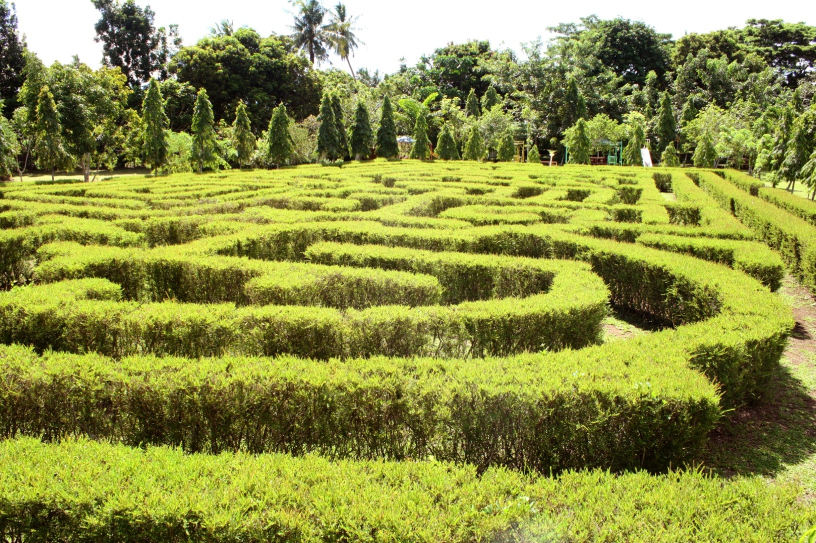
We found one….
http://naga.gov.ph/see-naga/attractions
Notes:
Urban park in Naga City, Philippines

Slide 14
Findings

Slide 15
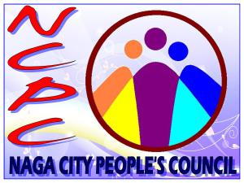
“Naga City People’s Council… concretizes the spirit of people’s participation and advances the principle of partnership in local governance by the local government.” (Naga City People’s Council website)
Notes:
- About governance in Naga

Slide 16
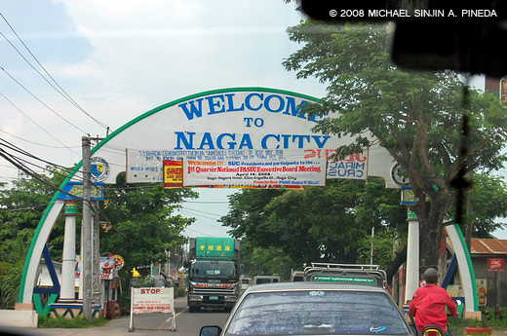
But how did it happen?
http://goturismoateneo.blogspot.ca/2012/10/naga-city-maogma-lhttpfarm4staticflickr.html
Notes:
- About what led to the changes in governance.

Slide 17
Grassroots groups didn’t collaborate with landlords and government to achieve equitable governance.

Slide 18
It was 20 years of struggle by grassroots groups that led to the institutionalization of new and equitable urban decision-making processes.
Notes:
There are lots of examples of this. They might not have led to institutionalized changes in urban governance processes (which was our benchmark), but there are countless examples of grassroots groups/social movements forcing change. It would be good to explore some of these together in the discussion.

Slide 19
Right now, in cities around the world, people facing barriers to socio-economic equality are working to dismantle these same barriers. But instead of receiving help from powerful actors, they are often met with enormous resistance that ranges from violence to co-optation.
Notes:
Everyone has to evaluate the risks and benefits of ‘opting out’ of processes or resisting processes. It depends on people’s positions, and, of course, where you are. Resistance can result in people facing violence from the state. In different context people could lose jobs, or housing. At the other end of the spectrum is the risk of co-optation. In which progressive voices, movement, energy are folded into non-progressive processes. This process is very well-documented in the American context in a collection of essays called The Revolution Will Not Be Funded.
I think what’s important is this perception that powerful/institutional actors are saying they’re trying to ‘help,’ when so often they/we will resist change in a million subtle and unsubtle ways.

Slide 20
I sit on a man's back, choking him, and making him carry me, and yet assure myself and others that I am very sorry for him and wish to ease his lot by any means possible, except getting off his back.
  Leo Tolstoy, Writings on Civil Disobedience and Nonviolence (1886)

Slide 21
Learnings?

Slide 22
So does it ever make sense for grassroots groups to collaborate with institutional processes?

Slide 23
Potentially constructive intersections:
When there are ‘genuinely non-conservative parties and independent grassroots groups. (Souza)
When resident groups have the resources they need to have clout in the process (eg. hired organizers, lawyers, etc.). (Arnstein)
When people want to learn about processes so they can take independent action, subvert processes, resist processes. (Souza, Olesen)

Slide 24
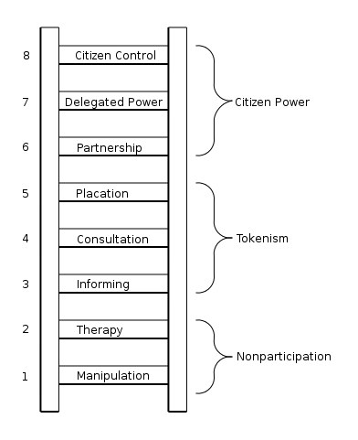
Ladder of Citizen Participation
Sherry Arnstein, 1968 [Arrows inserted by us!]
Notes:
Does the whole ladder have integrity? Of maybe just some of the rungs? Is it really a continuum?

Slide 25
Tips that are not tips
Notes:
Why we don’t like tips

Slide 26
So… What can organizations that want to collaborate, that are mandated to collaborate, that feel they should collaborate, do?

Slide 27
#1
Be clear about you/your organization’s motivations, intentions and limits. Unpack the point of the exercise. It’s not always easy to see this at first. Take time to reflect. Stop for second if you can (even though many forces will often conspire to stop you from stopping for a second).

Slide 28
#2
Once you understand what you are actually doing and who you are serving (eg. is your first allegiance to a funder, an organization, a management structure, etc. – or is the process genuinely able to consider and respond to input), communicate transparently about the process. If the process is not binding – if input from ‘stakeholders’ is to be treated as suggestions – make this clear. Are there resources on the table? Quantify them. People deserve to know what they/we are engaging in.

Slide 29
#3
If you can do so without co-optation (eg. trying to control the agenda, sucking up people’s time into organizationally-defined projects, burdening them with excessive paperwork, etc.), offer resource progressive grassroots groups:
Funds
Space
Healthy food
Child care
Facilitation supports
Transportation supports
Printing
Legal services
Hoteling (providing desk, computer, phone, etc.)
Trusteeship (i.e. flowing funds)

Slide 30
None of these suggestions would be easy or even always safe to operationalize in many organizations.
There are no easy answers to any of this…
And, sometimes, trying to create protocols for and/or functionalize what are, essentially, creative and even subversive processes can drain them of their meaning.

Slide 31
So maybe the best thing to do is starting talking about it together and see what happens.

